Slide 1



Types of Software Testing: Functional vs Non-Functional
Software testing ensures high-quality software. There are two main types: functional and non-functional. Functional testing focuses on whether the software functions as intended. Non-functional testing focuses on performance, security, usability, and other aspects that impact user experience.
by OON RAZA

Slide 2

Functional Testing
Functional testing verifies that software meets specified requirements and performs as expected.
It involves evaluating features, functionalities, and user interactions.

Slide 3

Types of Functional Testing (Smoke, Sanity, Regression)
Smoke Testing
Sanity Testing
A quick check to ensure basic functionalities are working.
Verifies a specific area of functionality after minor changes.
Regression Testing
Ensures that new changes don't negatively impact existing functionalities.

Slide 4
Non-Functional Testing
Non-functional testing evaluates software quality aspects beyond core functionalities.
It ensures the software's performance, security, usability, and other user-centric factors are optimal.

Slide 5

Types of Non-Functional Testing (Performance, Load, Security)
Performance Testing
Load Testing
Evaluates how well software performs under various conditions.
Assesses the software's behavior under heavy user load.
Security Testing
Identifies vulnerabilities and ensures data protection.

Slide 6
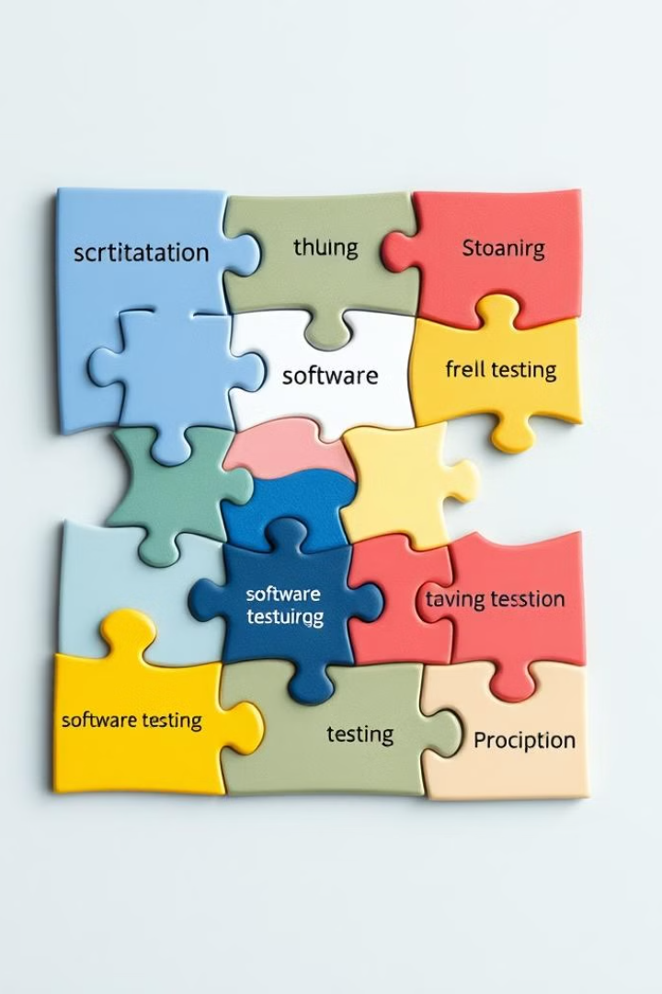



Why Different Types of Testing are Necessary?
Quality Assurance
User Experience
Ensures that software meets predefined quality standards.
Improves user satisfaction by addressing usability and performance concerns.
Data Protection
Mitigates security risks and safeguards sensitive information.

Slide 7
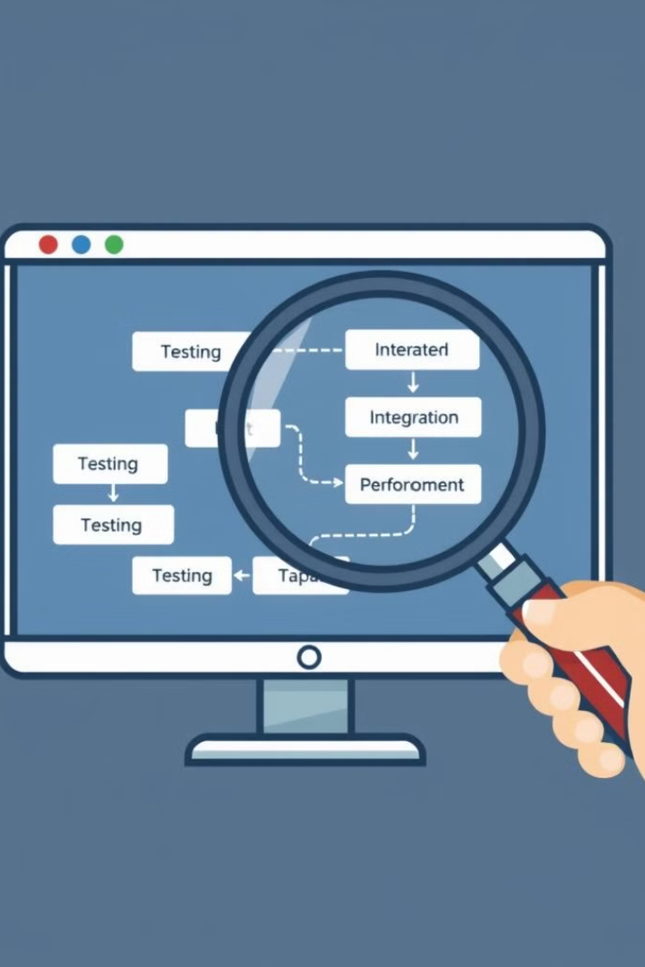
How to Perform Various Types of Testing?
1
Define clear testing objectives and criteria.
2
Use appropriate testing tools and techniques.
3
Document test cases and results for future reference.
4
Analyze findings and report issues to developers.

Slide 8





Benefits of Using Multiple Testing Types for Quality Assurance
Reduced Defects
Comprehensive testing helps uncover bugs early in the development cycle.
Improved Performance
Performance testing ensures optimal software behavior under load.
Enhanced Security
Security testing strengthens software against vulnerabilities.
Increased User Satisfaction
Usability and non-functional testing result in a better user experience.

Slide 9

Conclusion
By implementing functional and non-functional testing, software development teams can deliver high-quality products that meet user expectations and business needs.

Slide 10

Source Links of Websites from Where Data is Collected
For in-depth information, please refer to the following sources:
Website 1: https://www.guru99.com/software-testing.html
Website 2:https://www.softwaretestinghelp.com/types-of-software-testing/

Slide 11



